Slide 1
DATA ANALYTICS PROJECT
RETAIL DOMAIN

Slide 2
OBJECTIVES
Average Discount offered based on return policy
Customer Segmentation
Creating Dynamic Pricing Strategy
Optimizing Discount Percentage
Correlation between Stock turnover rates and Product ratings

Slide 3
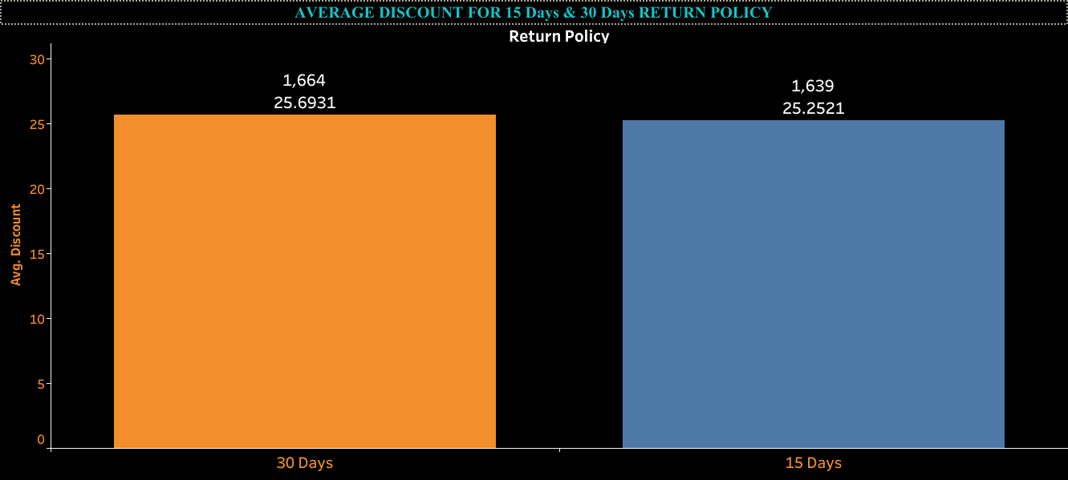
From the Visualization we can see Average discount for both 30-days and 15-days return policy and we observe that the average discount offered under the 30-day return policy is higher than the average discount under the 15-day return policy. This indicates a trend where longer return periods are associated with more substantial discounts. The higher average discount for the 30-day return policy suggests that customers are more likely to purchase when they perceive greater value through discounts. The longer return period makes customers feel safer, as they have more time to decide if they want to keep the product. Retailers offering a 30-day return policy tend to give more substantial discounts to sell products quickly and balance profits. Using higher discounts to encourage quick sales and reduce the likelihood of returns affecting overall profits.

Slide 4
KEY METRICS:
The average discount is calculated
Average Discount=∑(Individual Discounts)/Total Number of Discounts.
CONCLUSION :
Analysis shows that products with a 30-day return policy have an average discount of 25.6%, which is higher than the 25.2% average discount for products with a 15-day return policy.

Slide 5
CUSTOMER SEGMENTATION
Segmenting customers based on their purchasing behavior is an effective way to understand and target different customer groups. One common approach is to use the RFM (Recency, Frequency, Monetary) model. Here's how you can segment customers using RFM analysis:
To perform Customer Segmentation we need to have Purchase date, Purchase Amount, Customer ID
Calculate RFM Scores
Recency : Calculate the number of days since the last purchase for each customer.
Frequency: Count the total number of purchases made by each customer.
Monetary: Sum the total spending for each customer.
Assign scores for each RFM component. Typically, you can use a scale of 1 to 5, with 5 being the most recent, most frequent, and highest spending.
Combine the RFM scores to create a composite RFM score (e.g., R5-F5-M5 would be a top customer, while R1-F1-M1 would be a low-value customer).
Based on the combined RFM scores, segment your customers into different groups.

Slide 6
KEY METRICS:
RECENCY : DATEDIFF('day', MAX([Purchase_Date]), TODAY())
FREQUENCY : COUNT([Purchase_ID])
MONETORY : SUM([Purchase_Amount])
CONCLUSION:
To Calculate Recency, Frequency, Monetory our dataset should include Purchase Amount, Purchase Date and Customer ID. These are the additional data which need to be added in current retail dataset to segment customers.
By segmenting customers using the RFM model, you can better understand your customer base and tailor marketing strategies, promotions, and communications to different customer groups. This approach helps in optimizing customer engagement and driving sales growth.

Slide 7
Dynamic pricing strategy based on product ratings and reviews
Dynamic pricing strategy in the retail domain involves adjusting the prices of products in real-time or periodically based on various factors such as demand, competition, seasons, market conditions, and customer behavior.
Creating a dynamic pricing strategy based solely on product ratings and reviews is possible but may not be comprehensive enough to optimize pricing effectively.
Dynamic pricing can help businesses maximize their revenue and profitability by ensuring that prices are always optimized for current market conditions.
Ratings and reviews provide valuable insights into customer satisfaction and product quality, but they represent only one dimension of the factors that typically influence pricing decisions.
Impact on Overall Sales Revenue:
Increased Revenue from High-Rated Products:
By increasing prices for highly-rated products, you can capture higher value from customers who perceive these products as superior.
Improved Inventory Turnover for Low-Rated Products:
Reducing prices for lower-rated products can help clear out inventory and reduce carrying costs.

Slide 8
KEY METRICS:
High Rating and Reviews: If Rating > 4.5 and Reviews > 100, then Price = Price * 1.10
Moderate Rating and Reviews : If 4.0 <= Rating <= 4.5 and 50 <= Reviews <= 100, then Price = Price * 1.05.
Low Rating : If Rating < 3.5, then Price = Price * 0.90.
CONCLUSION:
Relying solely on ratings and reviews may not capture other important factors like demand fluctuations, seasonality, and competitor pricing.
Frequent price changes based only on ratings and reviews could confuse customers and lead to perceptions of unfair pricing.

Slide 9
What is the optimal discount percentage that maximizes both sales volume and profitability?
WHAT IS OPTIMAL DISCOUNT?
The optimal discount percentage involves finding a balance between increasing sales volume and maintaining profitability. The optimal discount maximizes total revenue and profit by attracting more customers and encouraging more purchases while ensuring the discounts do not erode profit margins excessively.
The optimal discount percentage should balance increasing sales volume with maintaining profitability. If a retailer increases the discount too much, it may lead to higher sales but reduced profit margins, potentially resulting in a loss for the business. Conversely, if the discount is too low, customers may not be interested in purchasing the products. Therefore, finding a median discount percentage can help achieve a balance, boosting sales volume while ensuring the business remains profitable.
Based on our analysis of the retail dataset, the optimal discount percentage that balances increasing sales volume while maintaining profitability has been determined using the median discount value.
The median discount percentage was calculated from the Discount column. The median is a robust measure of central tendency that is less influenced by extreme values, making it suitable for identifying a representative discount rate.
The median discount percentage calculated from the dataset is 25.79%.

Slide 10
Correlation between product ratings and stock turnover rates
The stock turnover ratio (STR) is a financial metric that measures how often a company's inventory is sold and replaced over a specific period.
KEY METRICS:
Stock Turnover Rate=Sales Volume​/Average Inventory
Sales Volume is the number of units sold in a given period.
Average Inventory is the average number of units held in inventory during the same period Sales Volume is the number of units sold in a given period.
To calculate Average Inventory:
Average Inventory=Beginning Inventory + Ending Inventory/2

Slide 11
Correlation between product ratings and stock turnover rates
Positive Correlation:
Higher ratings correlate with higher stock turnover, suggesting well-rated products sell faster.
Inventory management Decision: Increase inventory levels for highly rated products to meet higher demand and reduce stock outs.
Negative Correlation:
Higher ratings correlate with lower stock turnover, indicating high-rated products have longer sales cycles or are overstocked.
Inventory management Decision: Review inventory levels and adjust to avoid overstocking.
No significant Correlation:
No clear relationship is observed, indicating ratings might not significantly impact stock turnover.
Inventory management Decision: Consider other factors like seasonality, marketing, or price adjustments.
CONCLUSION :
To Calculate Stock turnover rate we need Sales volume present in dataset. Adding this significant data can help us analyzing the correlation between product ratings and stock turnover rates, retailers can make more informed inventory management decisions, optimizing stock levels to meet customer demand and enhance profitability.

